Slide 1
An Overview of Computer System
Introduction to Software Engineering and Computing
By Natnael T.

Slide 2
Content
Computing hardware trends
Software Vs. Program
Characteristics of good software
Type and Classes of Software
Software development life cycles(SDLC)

Slide 3
Components of Computing System

Slide 4
Computing Hardware Trends
Trend: a general direction in which something is developing or changing.
Computing hardware trends: changes or evolutions in the ways that computer hardware are used which become widespread and integrated into popular thought with regard to systems and computing devices.

Slide 5
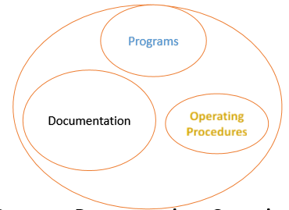
Software Vs. Program
Components of software
Software = Program + Documentation + Operating Procedures
Software is more than programs.

Slide 6
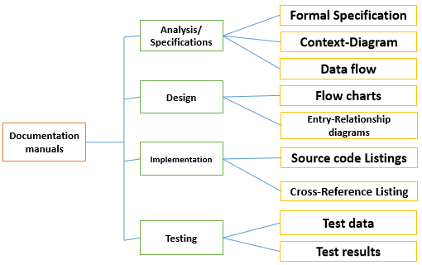
Any program is a subset of software and it becomes software only if documentation and operating procedure manuals are prepared.
Documentation consists of different types of manuals.

Slide 7
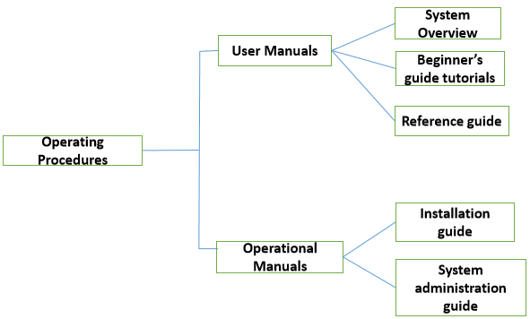
Operation procedures manuals consist of instructions
to setup and use the software system and
how to react to system failure.

Slide 8
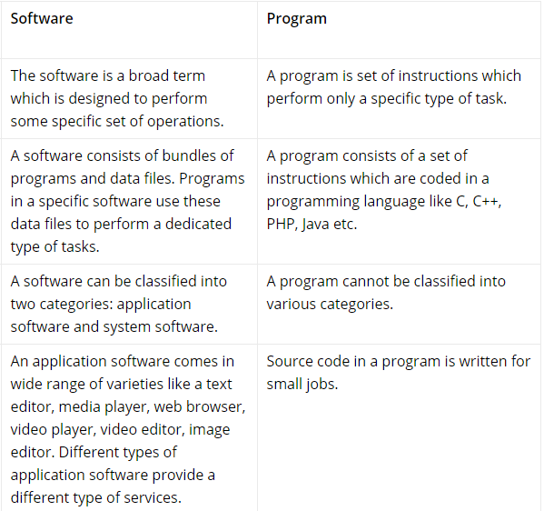
Software Vs Program

Slide 9
Characteristics of good SW
Operational: how well it is working
Budget - Usability
Efficiency - Correctness
Functionality - Safety and Security
Transitional: movability across platforms
Portability - Interoperability
Reusability - Adaptability
Maintenance: ability to maintain itself in changing environment
Maintainability - Flexibility
Scalability

Slide 10
Types and Classes of Software
System Software
It is a type of computer software that is designed for running the computer hardware parts and the application programs.
Operating system is an example of System Software
For desktop computers, laptops and tablets:
Microsoft Windows
Mac (for Apple devices)
Linux
For smartphones:
Apple’s iOS
Google’s Android
Windows Phone OS

Slide 11
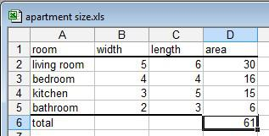
Cont’d
Application Software
It is designed for the users to perform some specific tasks like writing a letter, listening to music or watching any video.
Example: An application software program for making spreadsheets.

Slide 12
Cont’d
Application Software Type | Examples
Word processing software | MS Word, WordPad and Notepad
Database software | Oracle, MS Access etc.
Spreadsheet software | Apple Numbers, Microsoft Excel
Multimedia software | Real Player, Media Player
Presentation Software | Microsoft PowerPoint, Keynotes
Enterprise Software | Customer relationship management system
Information Worker Software | Documentation tools, resource management tools
Educational Software | Dictionaries: Encarta, BritannicaMathematical: MATLABOthers: Google Earth, NASA World Wind
Simulation Software | Flight and scientific simulators
Content Access Software | Accessing content through media players, web browsers
Application Suites | OpenOffice, Microsoft Office
Types of Application Software
The different types of application software include the following:

Slide 13
Programming Software
is the type of software that is used by software programmers
are programs that are used to write, develop, test, and debug other software, including apps and system software.
They are facilitator software used to translate programming languages (i.e., Java, C++, Python, PHP, etc) into machine language code.
Examples: Different programming language editors, debuggers, compilers and IDEs are examples of programming software like Eclipse, Notepad++, Android studio etc…

Slide 14
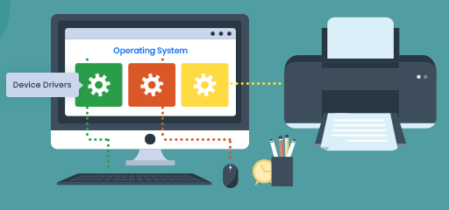
Driver Software
They operate and control devices and peripherals plugged into a computer.

Slide 15
Software Development Life Cycle - SDLC

Slide 16
SDLC
Software development process
Sequence of stages in software engineering to develop software product.
Series of steps to be followed to design and develop a software product efficiently

Slide 17
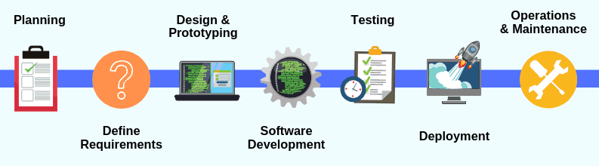
SDLC
Source: Internet

Slide 18
Stages of SDLC
Planning and Requirement Gathering
Requirement analysis: Expectations of users from the software product
Feasibility study: Detailed study by the analysts whether the desired system and its functionality are feasible to develop.
Planning: for the quality assurance requirements and identification of the risks associated with the project.

Slide 19
Stages of SDLC- cont’d
2. Defining Requirements
Clearly define and document the product requirements and get them approved from the customer
Software Requirement Specification (SRS): document which consists of all the product requirements to be designed and developed during the project life cycle.

Slide 20
Stages of SDLC- con’t
3. Designing
Uses SRS as a reference
Design Document Specification(DDS): document which clearly defines all the architectural modules of the product along with its communication and data flow representation with the external and third party (if any) modules.

Slide 21
Stages of SDLC- con’t
4. Software Development (Implementation)
The programming code is generated as per DDS
Different high level programming languages such as C, C++, JavaScript, Java and PHP are used for coding.
The programming language is chosen with respect to the type of software being developed.

Slide 22
Stages of SDLC- con’t
5. Testing
Software defects are reported, tracked, fixed and retested, until the software product reaches the quality standards defined in the SRS.
Checks whether the developed system
meets the requirements
responds correctly to all kinds of inputs,
performs its functions within an acceptable time
can be installed & run in its intended environment
achieves stakeholder’s desire.

Slide 23
Stages of SDLC- con’t
6. Deployment
all of the activities that make a software system available for use.
The product may first be released in a limited segment and tested in the real business environment (UAT- User acceptance testing).

Slide 24
Stages of SDLC- con’t
7. Maintenance
is the process of modifying a software product after it has been delivered to the customer.
Need for Maintenance
Correcting faults
Improving the design
Implementing enhancements/new features etc…

